Slide 1

Bike Showroom
ADHITHYA SANKAR

Slide 2
DATA FLOW DIAGRAM

Slide 3
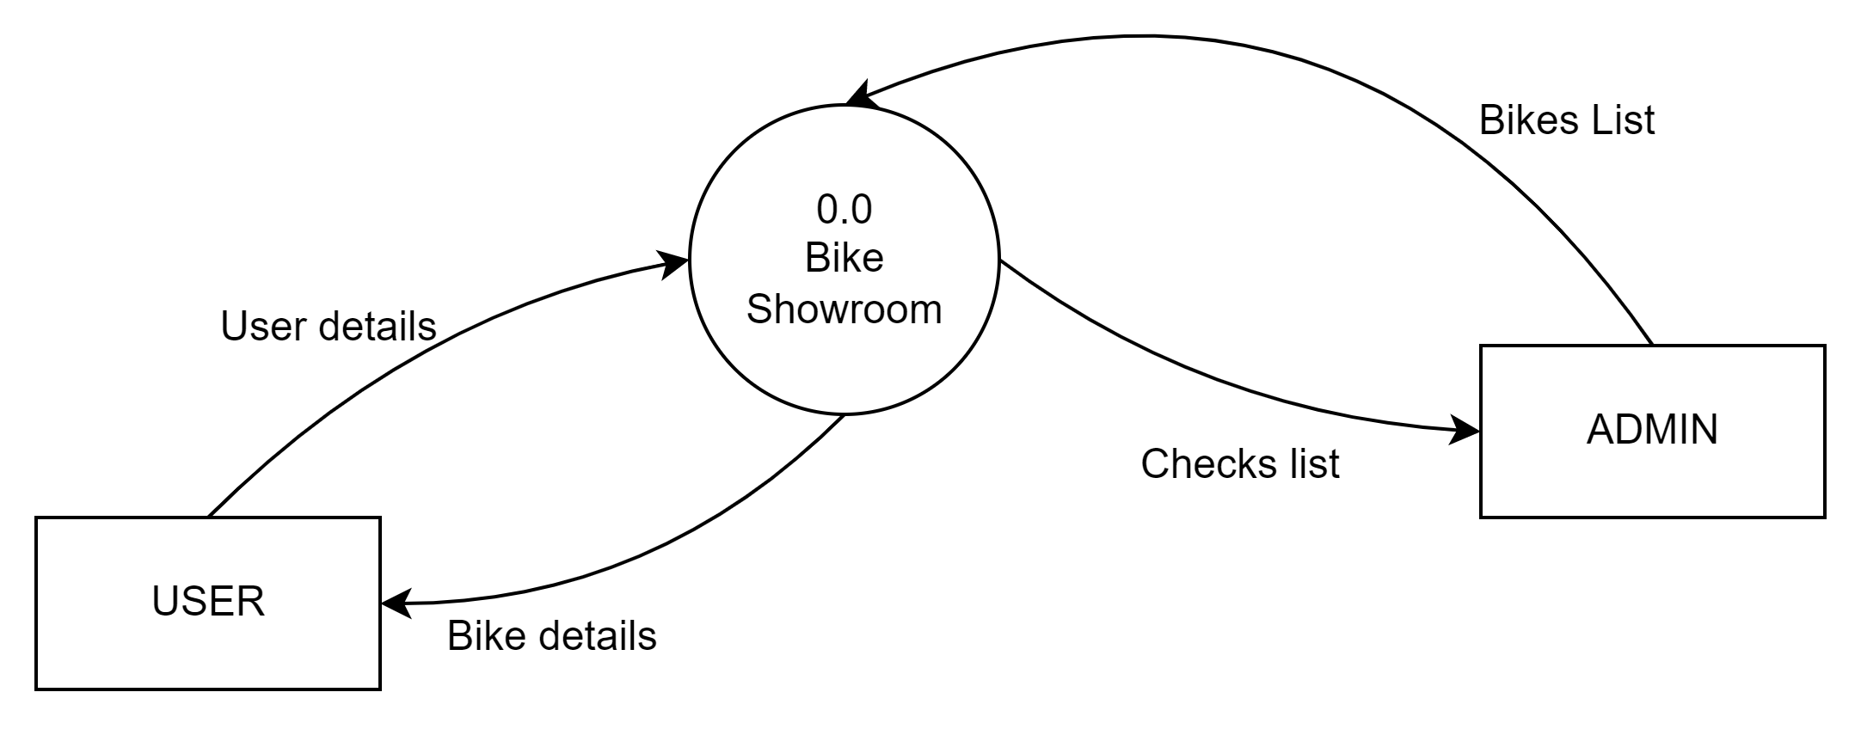
LEVEL 0 DATA FLOW DIAGRAM

Slide 4
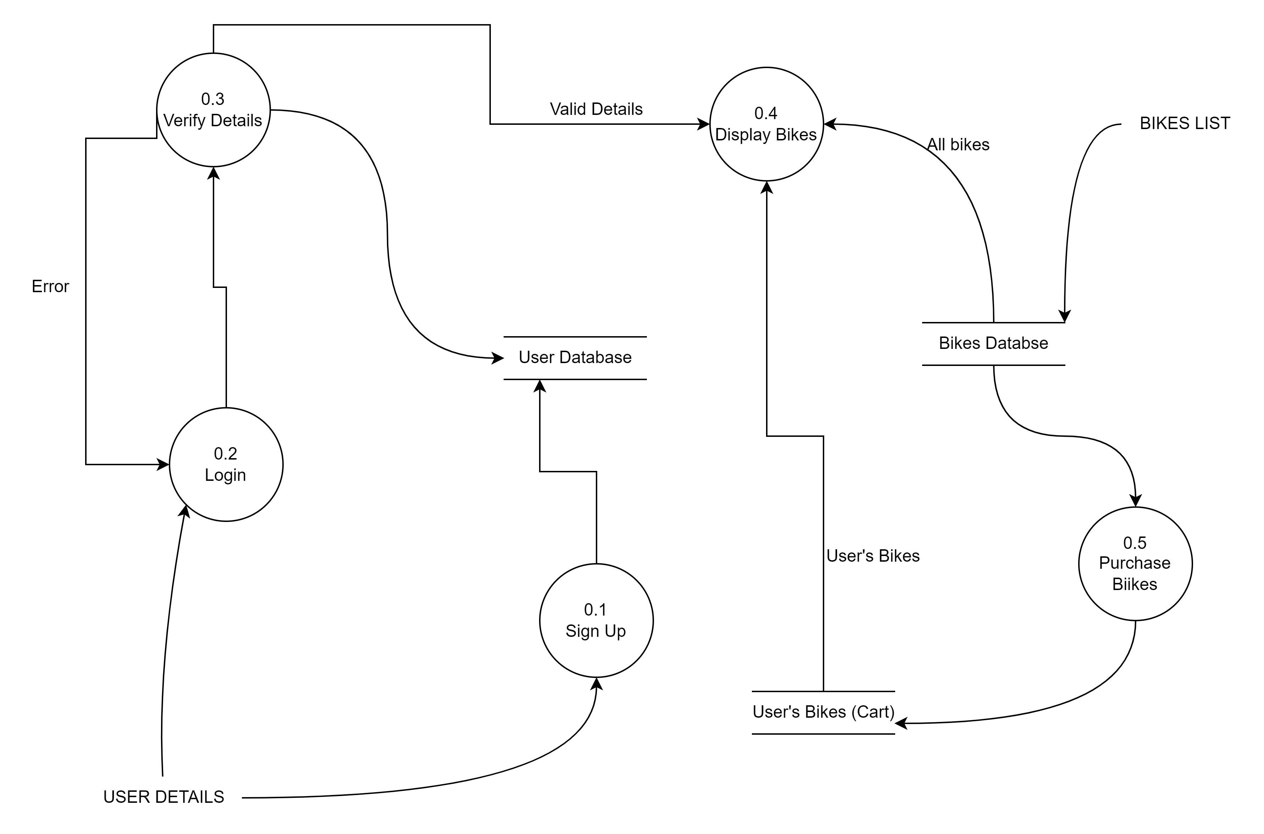
LEVEL 1 DATA FLOW DIAGRAM

Slide 5
DATABASE SCHEMA

Slide 6
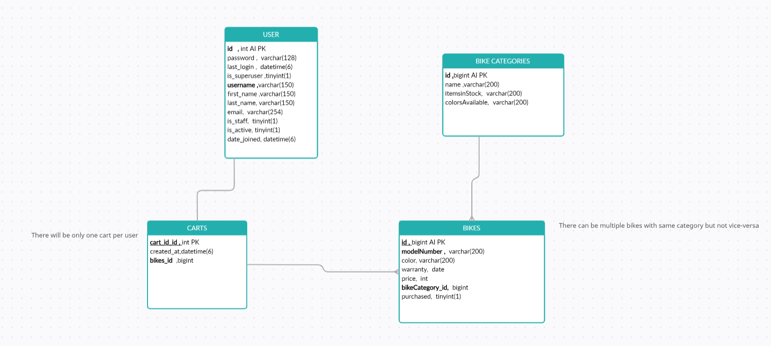

Slide 7
THANK YOU

